Slide 1
ESS AI Assistant
General Project Overview
An AI-powered assistant designed to help users access, understand, and analyze Ethiopia Statistical
Service information.
1

Slide 2
1. Project Purpose
Why ESS AI is being developed
Make official ESS statistical information easier to discover and understand.
Allow users to ask questions in natural language instead of searching through long reports manually.
Provide answers from ESS PDF publications using Retrieval-Augmented Generation (RAG).
Support analytical questions on ESS datasets such as agriculture, education, health, and roster data.
Create a modern AI experience that can eventually be embedded directly into the official ESS website.
2

Slide 3
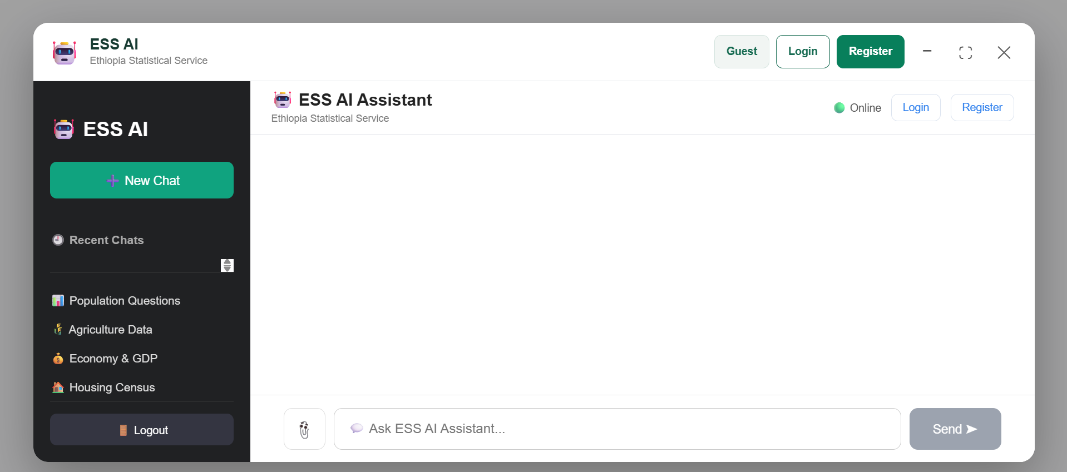

Slide 4
2. Main Capabilities
The assistant combines information retrieval, AI generation, and data analysis
📄 PDF / RAG
Ask questions about ESS reports and
publications.
📊 CSV Analytics
Calculate statistics and answer dataset
questions.
📤 PDF Upload
Upload a report and retrieve answers
specifically from it.
⚡ Streaming
Responses are streamed to improve
perceived speed.
🔐 Accounts
Guest access plus login/register and
saved chat history.
🤖 Embeddable AI
Floating assistant designed for future
ESS website integration.
3

Slide 5
3. High-Level Architecture
How the major components work together
User
ESS website / AI UI
→
React Frontend
AIMode • ChatBox • Widget
→
FastAPI Backend
API • Auth • Chat
→
AI Services
RAG • CSV AI
ESS Data
PDF + CSV
ChromaDB
Vector search
Ollama
Local LLM
4

Slide 6
4. PDF Question Answering (RAG)
The core workflow for ESS reports
1. ESS PDF is uploaded or selected.
2. PyMuPDF extracts text from the document.
3. Text is divided into overlapping chunks.
4. Sentence-transformers creates embeddings for the chunks.
5. ChromaDB stores the chunks and metadata, including the uploaded file_id.
6. A user question is embedded and relevant chunks are retrieved.
7. Reranking prioritizes the most useful evidence and report content.
8. Ollama generates an answer using the retrieved ESS context.
5

Slide 7
5. CSV Data Analysis
Turning ESS datasets into natural-language answers
Dataset Detection
Identifies whether the question
is related to agriculture, education,
health, roster, or another ESS dataset.
Data Operations
Current operations include
row count, average, median, maximum,
and unique values.
Codebook
Variable descriptions can be mapped
through a codebook/dictionary so results
are easier to interpret.
Planned extensions: standard deviation, variance, quartiles, percentiles, and correlation.
Goal: make official statistical datasets accessible without requiring users to write code.
6

Slide 8
6. Uploaded PDF Workflow
Ensuring answers come from the document the user selected
① Upload
User selects PDF
② file_id
Backend returns unique ID
③ Index
Chunks store file_id
④ Ask
Message + file_id
⑤ Retrieve
Only that PDF
This prevents a question about an uploaded report from accidentally retrieving unrelated ESS documents.
The same file-specific retrieval mechanism supports report-focused summaries and exact-value questions.
7

Slide 9
7. User Experience
Current AI interface
Floating ESS AI
A persistent button opens the assistant
without replacing the main website.
AI Popup
Existing AIMode, ChatBox, sidebar, and
controls remain together.
Window Controls
Minimize, maximize, restore, and close
are supported.
Authentication
Guest, login, and registration flows are
available.
Chat History
Logged-in users can keep previous
conversations.
Streaming
AI output appears progressively instead
of waiting for the full response.
8

Slide 10


Slide 11
8. Technology Stack
Current implementation
Frontend
React + Vite + JavaScript
Backend
Python + FastAPI
Database
PostgreSQL + SQLAlchemy
Authentication
JWT-based authentication
RAG
ChromaDB + sentence-transformers
PDF Processing
PyMuPDF
LLM
Ollama with a lightweight local model
Data
ESS PDF reports + CSV datasets
9

Slide 12
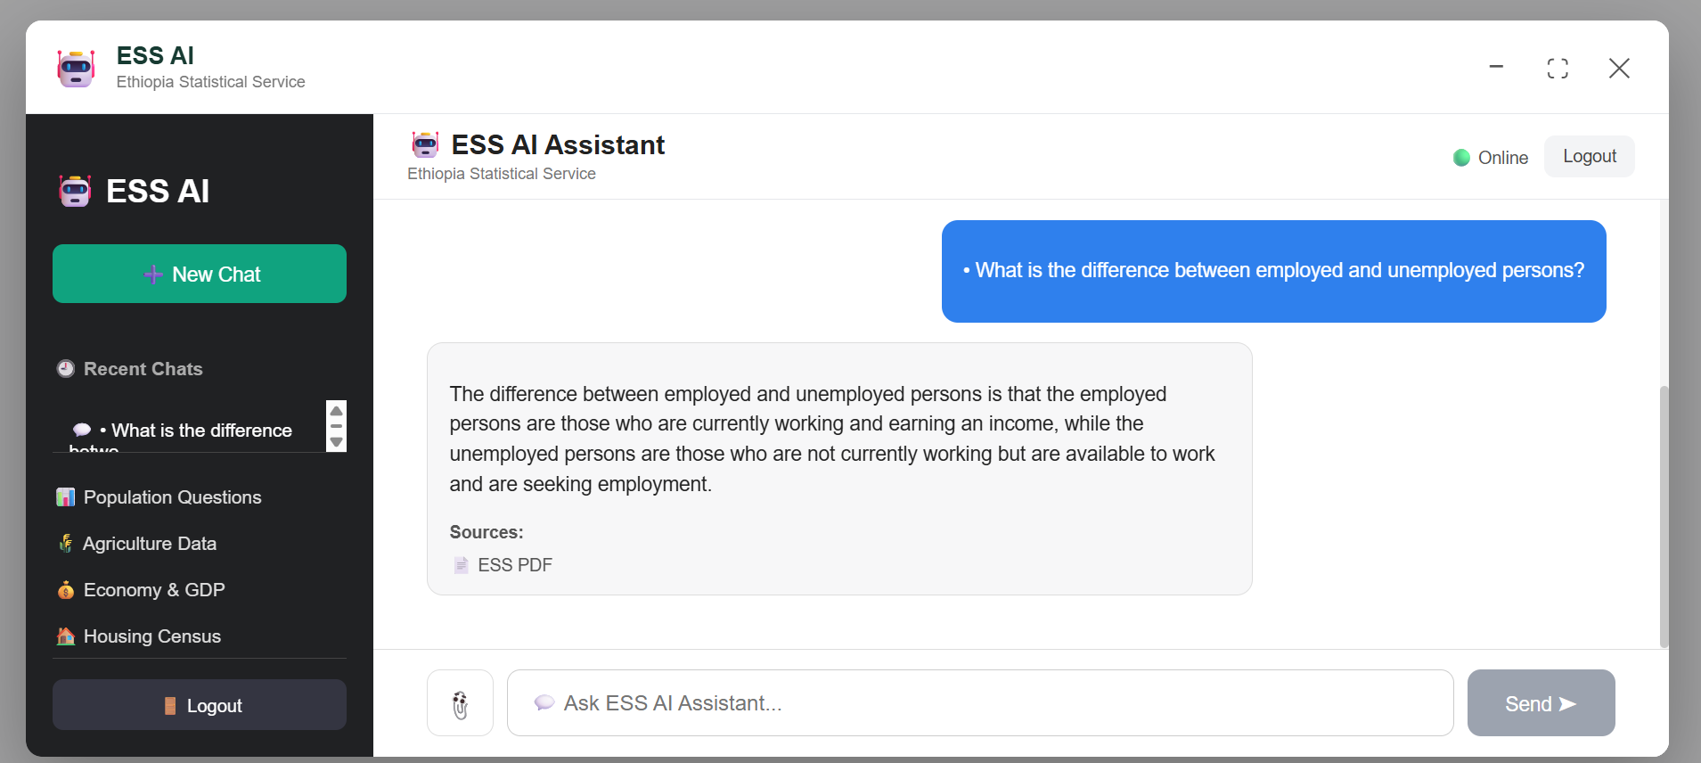

Slide 13
9. Performance & Reliability Focus
Key engineering priorities
Fast retrieval: retrieval and reranking have been optimized to reduce response latency.
Intent-aware retrieval: summary questions, exact-value questions, and other question types can be handled differently.
Evidence-based generation: the model is instructed to answer only from supplied ESS context and not guess.
File-specific retrieval: uploaded PDFs are isolated using file_id metadata and ChromaDB filtering.
Streaming responses: improves user-perceived responsiveness while the model is generating.
10

Slide 14
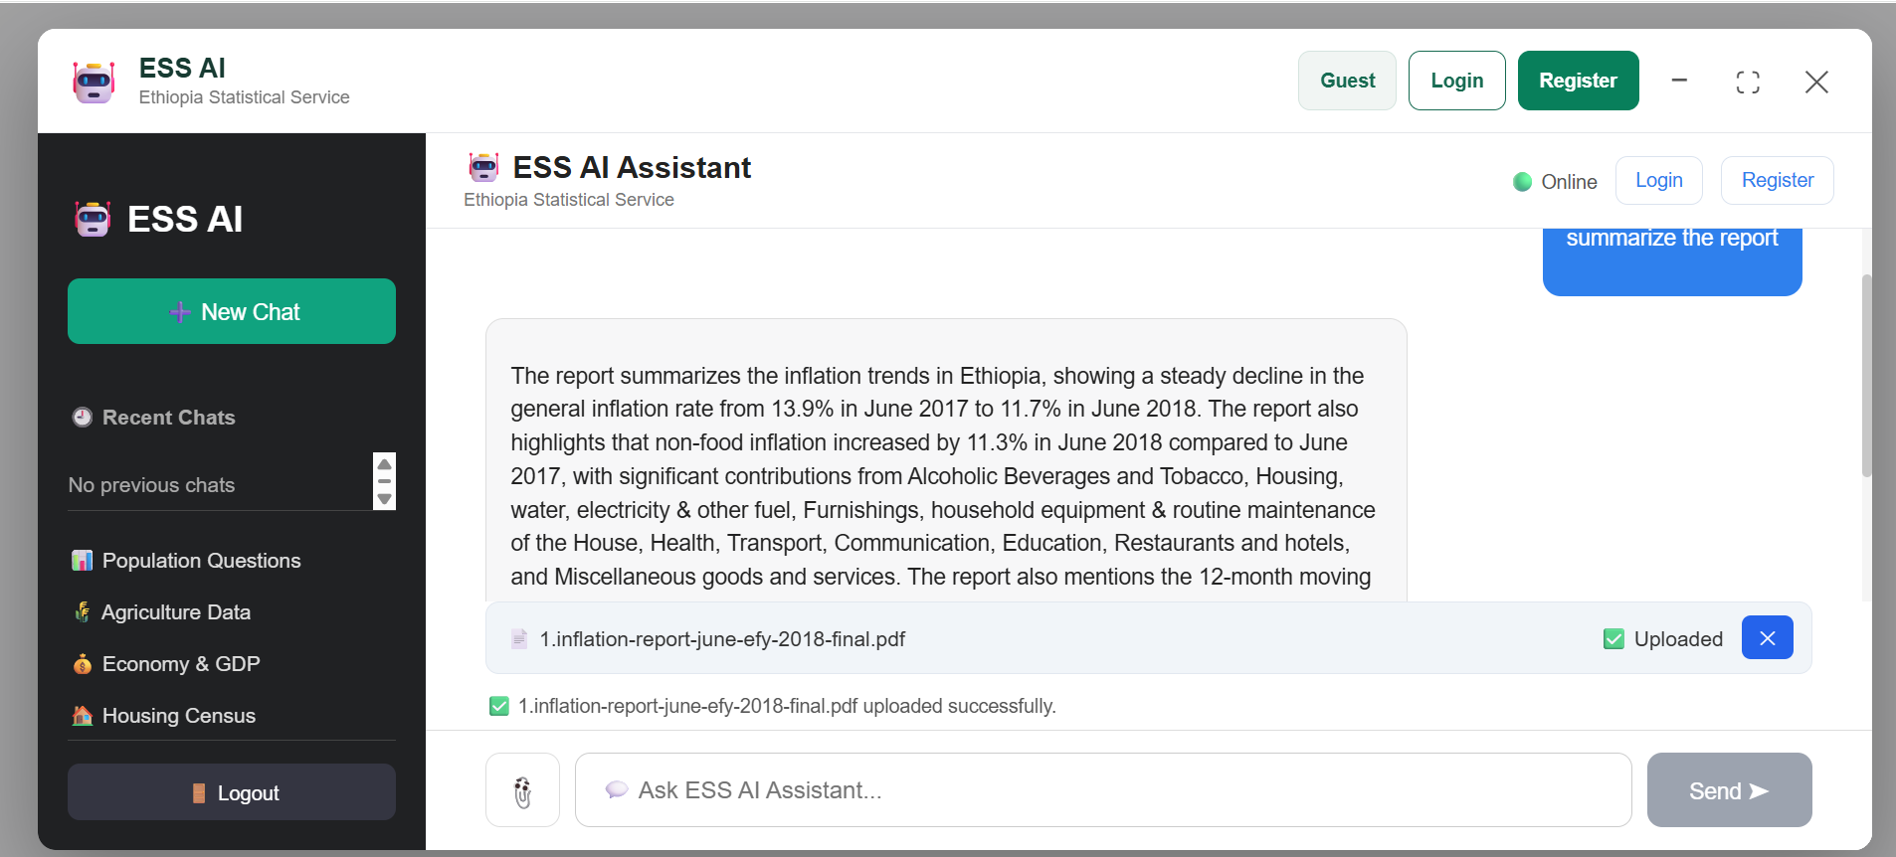

Slide 15
10. Next Phase: Official ESS Website Integration
Moving from the standalone React project to an embeddable service
Current
AI widget runs inside the
development React application.
Next
Create a dedicated embed entry
point and production deployment.
Target
Official ESS website loads a small widget
script that opens the existing AI.
Recommended architecture: official ESS website → widget loader → iframe → existing React AI.
This keeps the current AI interface intact while isolating its CSS and JavaScript.
Production deployment will require public HTTPS URLs and appropriate FastAPI CORS configuration.
Authentication and navigation behavior will be adapted for the embedded environment.
11

Slide 16
conculsion
I try to Build a trustworthy, fast, and accessible AI assistant that helps
people discover,understand, and analyze official Ethiopian statistics.
12

